Slide 1

Introduction to International Law

Slide 2

Background
International Law is study of the interactions between states over time. (Example: ambassadors, Doot)
The history of international Law is a history of events, doctrines, states practices and theories about law. (Example: restricted sale of Tobacco)
It is also a history of ideas, the attempts of scholars and jurists over the centuries to present the coherent accounts on how state behaves and how international laws is made.

Slide 3
How international law evolved
A version of international law existed for thousands of years.
Mesopotamia, Greece, China and India formulated rules to govern relations between members of their own system.
These law included: provision for the treatment of diplomats, making of enforcement of treaties and principles governing declaration and conduct of War ( Remember the scene Mahabharata/ Ramayana)

Slide 4

When the international community/state needed the law?
Powerful states ignore IL
But they needed when they faced turmoil and war. (Example Piracy around SLOCS)
Thus after each and every big turmoil or war new laws were made/amended.
1. The Thirty Years war in Europe (1618-1648)
2. European powers’ wars over Colonial expansion in Africa and Asia (1880s onwards)
3. World War I ( 1914-1918)
4. World War II ( 1939-1945)

Slide 5
Peace of Westphalia (1648)
Treaty of Westphalia was signed after the Thirty Years War.
But why did the war break out?
The relationship between the Church and the feudal states during the medieval period went through a number of developments.
The struggles for power between kings and popes shaped the western world.
Some states sided with the Church, and others not.
Treaty Of Westpahlia: Sovereignty of States was established

Slide 6
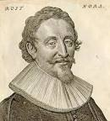
Role of Jurists: Hugo Grotius
Hugo Grotius (The Rights of War and Peace, 1625) argued: the great principles of law- whether in relations to war, commerce, or the formation of treaties could be derived from nature or reason rather than God.
His major achievement lay in shifting the basis of law from religion to natural law or law based on reason.
According to Grotius one of the fundamental principles of this natural law should be Pacta Sunt Servenda (Treaties must be obeyed).

Slide 7
Pacta Sunt Servenda –still regarded as a foundation of modern international law.
Now what was Treaty of Westphalia?
30 yrs war ended with a peace settlement:
It sought to prevent further religious conflict
A) Each Sovereign state has absolute power within its territory and therefore could adopt whatever religion and political system it thought fit

Slide 8
B) No state was justified in attacking another state simply because that other state had a different ideology or religion.
It also included a provision that required states to protect the rights of the minorities within their territories.
Emergence of Sovereign state or Nation State ( Elaborate)

Slide 9
Only sovereign entities have full standing in the international system- to bring claims to make international law, and to create international institutions.
The Peace of Westphalia can be seen as the beginning of a historical process by which the state became more consolidated. It has its own rationality that was independent of religious consideration and ethics.

Slide 10
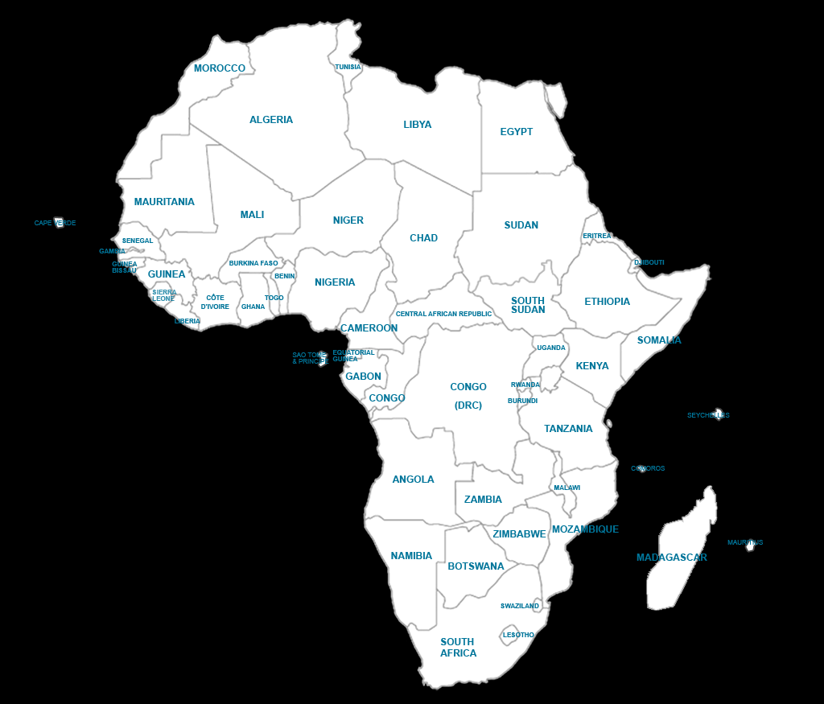
Berlin Conference (1884-85)

Slide 11
The scramble for Africa and Berlin Conference
https://www.pbslearningmedia.org/resource/6031c3a2-ada9-42b4-8045-52006e2a2b07/the-berlin-conference-of-1884-1885/
The competition between European state for Africa also known as the scramble for Africa threatened to result in war.
They met in Berliand and, devised a system that would enable a system to enable the ‘orderly’ exploitation of Africa without risking war.
Sought to end slavery and ensure well being of the natives. (Jus Cogens)

Slide 12
Sought to end slavery and ensure well being of the natives.
However, Leopold attempted to exploit the riches of Congo- including ivory and rubber- causing deaths of millions of Africans.
Punished Africans who failed to meet the quota by cutting their hands.

Slide 13
Law of War (1899, 1907)
Two conferences held in The Hague, Netherland (1899, 1907) and discussed
1. Jus ad bellum ( when it is legal to go to War)
2. Jus in Bello (laws to be observed when the war has begun). According to this principle, it was illegal for armed forces to deliberately target civilians during the war.
ICRC played an important role in these proceedings.

Slide 14
International Law from 1919-1939
World War I (1914-1918) ended. Treaty of Versailles signed, League of Nations established.
L.N: first major attempt to coordinate the behaviors of states through an International Body/Organisation.
1. L.N expected all members to “respect and preserve the territorial integrity and political independence of states against external aggressions.”
2. Reduce armament to “the extent compatible with their own security and international obligations.”
3. Submit a dispute for arbitration or judicial settlement. ( meaning do not use force as a first resort).

